Slide 1


Mechanical Components

Slide 2
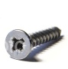
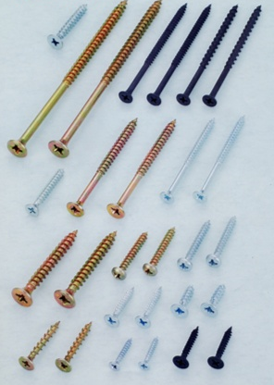
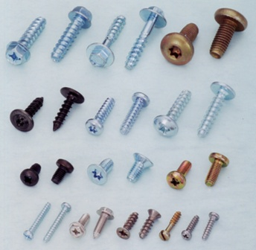
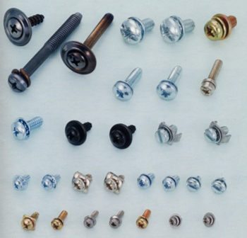
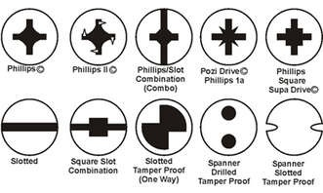
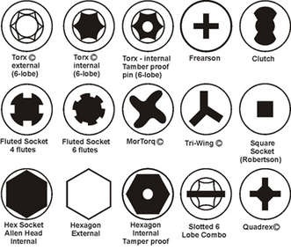
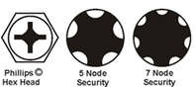
Fasteners & Locking Devices
Secure 2 or more parts together
Screws for different materials
Wood
Plastic
Machine
Difference in head & different tools are required

Slide 3
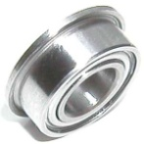
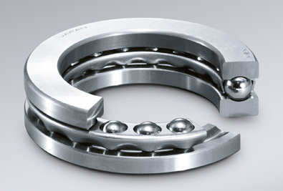
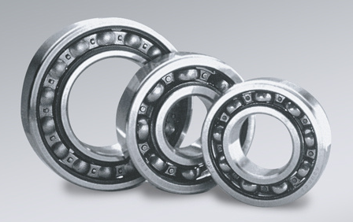
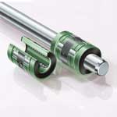
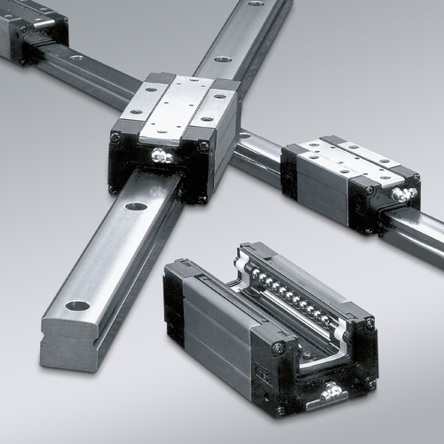
Bearings & Sliders
Reduce friction on moving components
Rotation
Axial
Radial
Sliding
Shafts
Other components

Slide 4

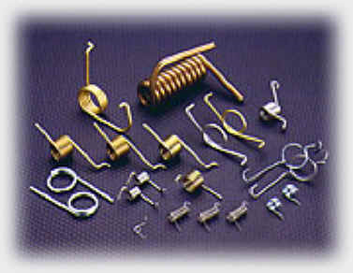
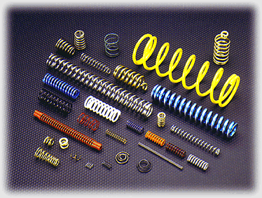
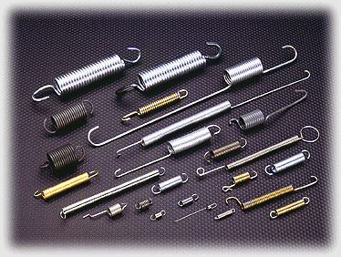
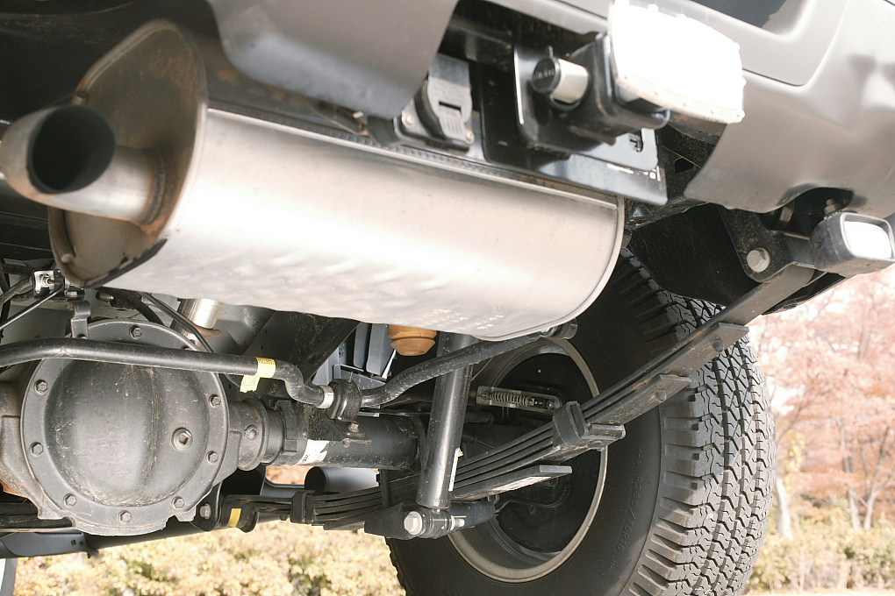
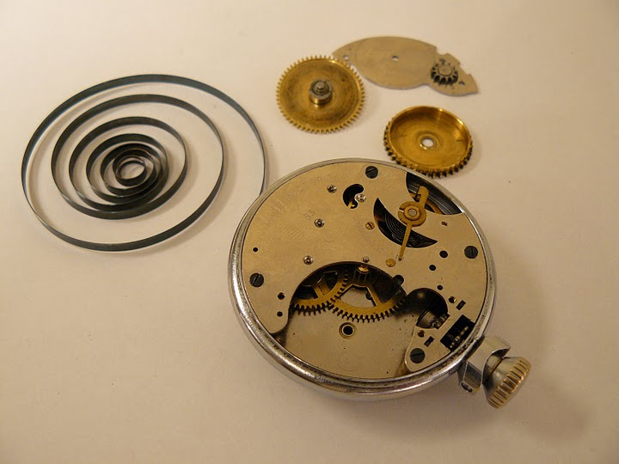
Springs
Stores energy from moving components
Rotation
Tension
Compression
Comes in different shapes
Leaf spring
Flat coil spring

Slide 5
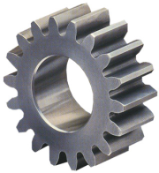
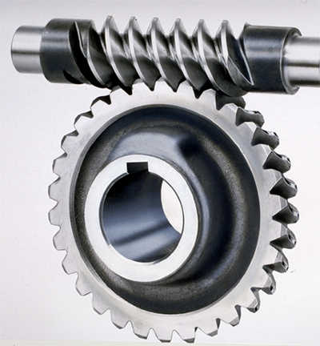
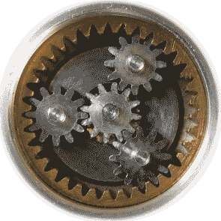
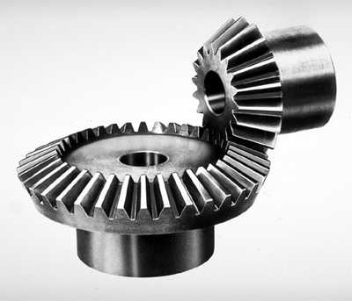
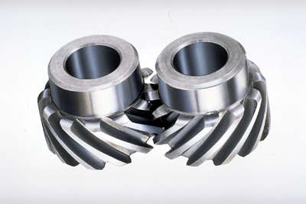
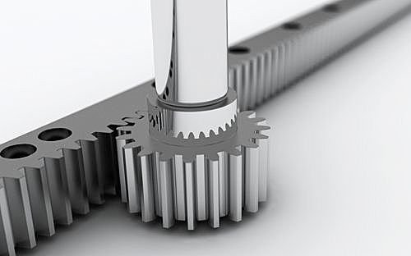
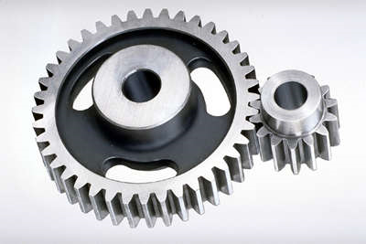
Gears
Transmit motion
Change speed or torque
Types
Spur
Bevel
Helical
Worm & worm wheel
Rack & pinion
Sun & planet

Slide 6
Gears – Calculating Speed/Gear Teeth
↑ rotational speed → ↓ torque
Equate gear ratio to speed and torque
Torque (Nm)
Gear Ratio
Speed
(rad/s) or RPM

Slide 7
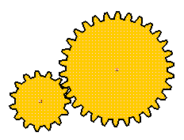
Gears – Calculate Speed
Gear 1 has 15 teeth & rotates at 100RPM
Gear 2 has 50 teeth
What is gear 2 speed(RPM)?
2
1

Slide 8
Gears – Calculate Torque
Gear 1 has rotates at 100RPM & has 10Nm
Gear 2 has rotates at 250RPM
What is gear 2 torque (Nm)
Which gear is which?
?
1
?
2

Slide 9
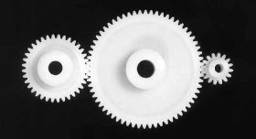
Gears - Characteristics
Changes direction
2 meshing gears rotate in opposing directions
Addition of the centre gear changes the direction of output gear
Direction of output is the same as the input gear

Slide 10
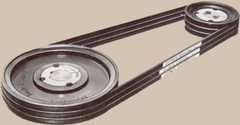
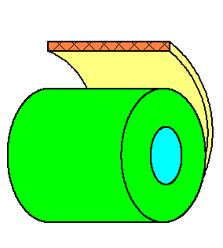
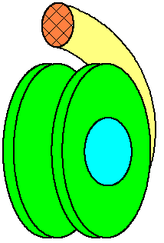
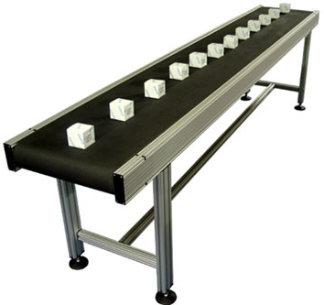
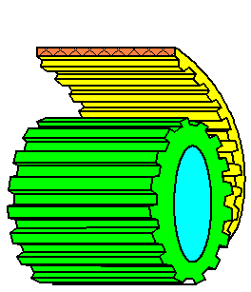
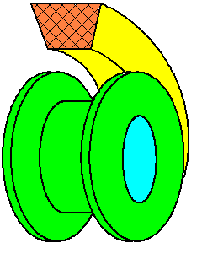
Belts & Pulleys
Transmits motion
Used to move objects
Types
Round belt
Flat belt
V-belt
Timing belt
Conveyer belt

Slide 11
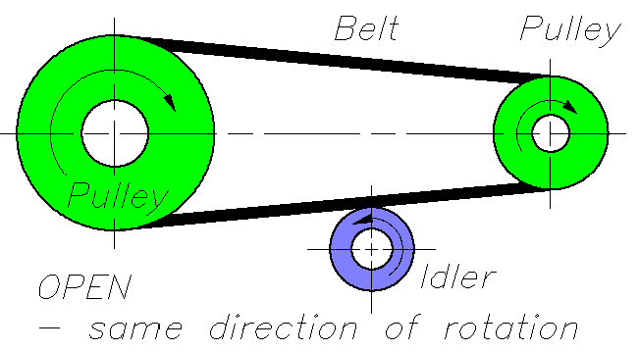
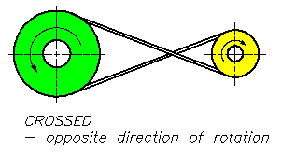
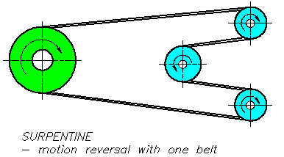
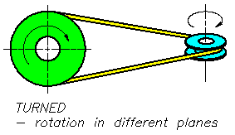
Belts & Pulleys – Installation
Open
Crossed
Turned
Serpentine

Slide 12
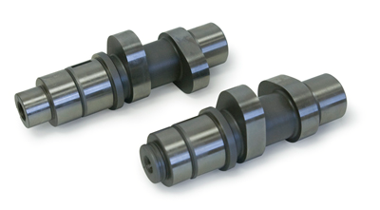
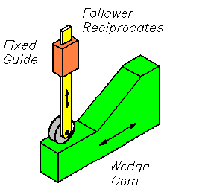
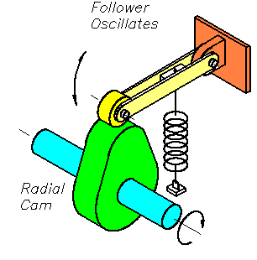
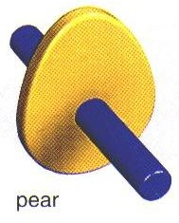
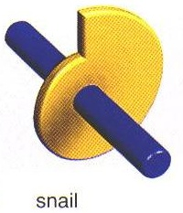
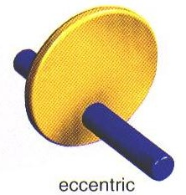
Cams
Transmits a specific desired linear motion from rotation or linear motion
Types
Radial cam
Pear
Snail
Eccentric
Wedge cam

Slide 13
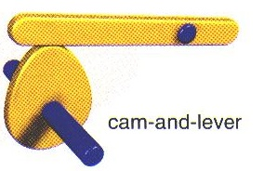
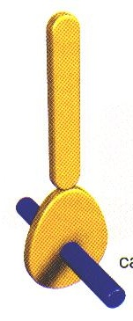
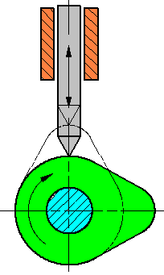
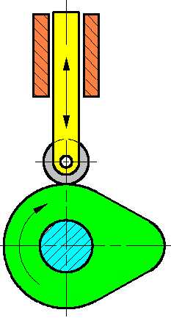
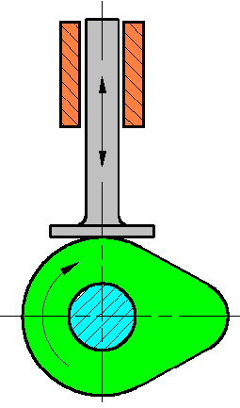
Cams – Followers
Types
Slider
Lever
Follower end types
Knife
Roller
Flat

Slide 14
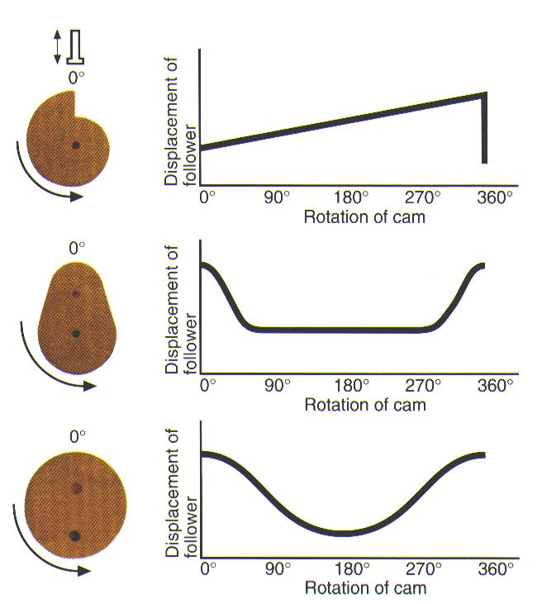
Cams – Types of Motion
Snail
Gradual increment, then a drop
Pear
Gentle increment and decrement between constant displacements
Eccentric
Smooth wave motion (sine/cosine)

Slide 15
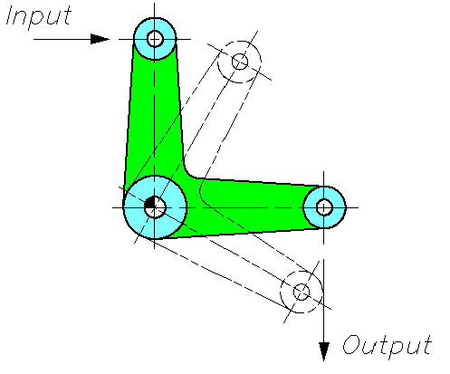
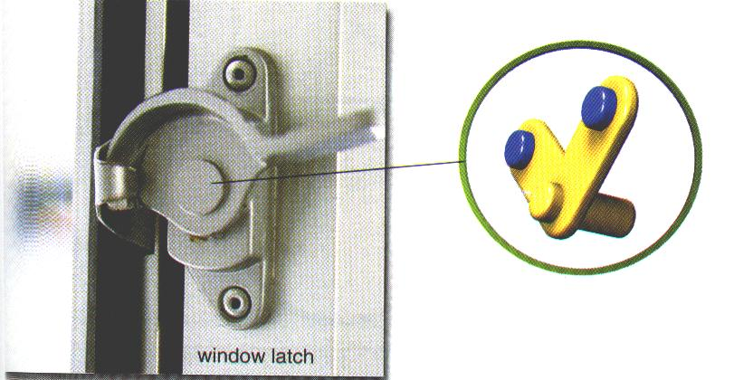

Mechanisms – Bell Cranks
Transmits motion & force
Ability to change the output motion & force
Increases mechanical advantage

Slide 16


Mechanisms – Cranks
Ability to rotate a shaft easier

Slide 17


Mechanisms – Linkages (1)
Toggle mechanism
A small effort is applied but a large force is generated

Slide 18


Mechanisms – Linkages (2)
Reverse motion
Reverts output motions

Slide 19


Mechanisms – Linkages (3)
Push-pull linkage
Output link moves and has the same force as the input link

Slide 20

Mechanisms – Linkages (4)
Rotary motion
A linear motion is converted to rotary and vice-versa

Slide 21



Mechanisms – Linkages (5)
Parallel motion
A parallel motion is transmitted to maintain a level motion

Slide 22




Mechanisms – Applications

Slide 23




Mechanisms – Screw Threads
Bench vice
Glue stick
Conveyer
Lead screw

Slide 24


Mechanisms – Ratchet & Pawl
Allows rotation in one direction

